Slide 1

UNTITLED

Slide 2
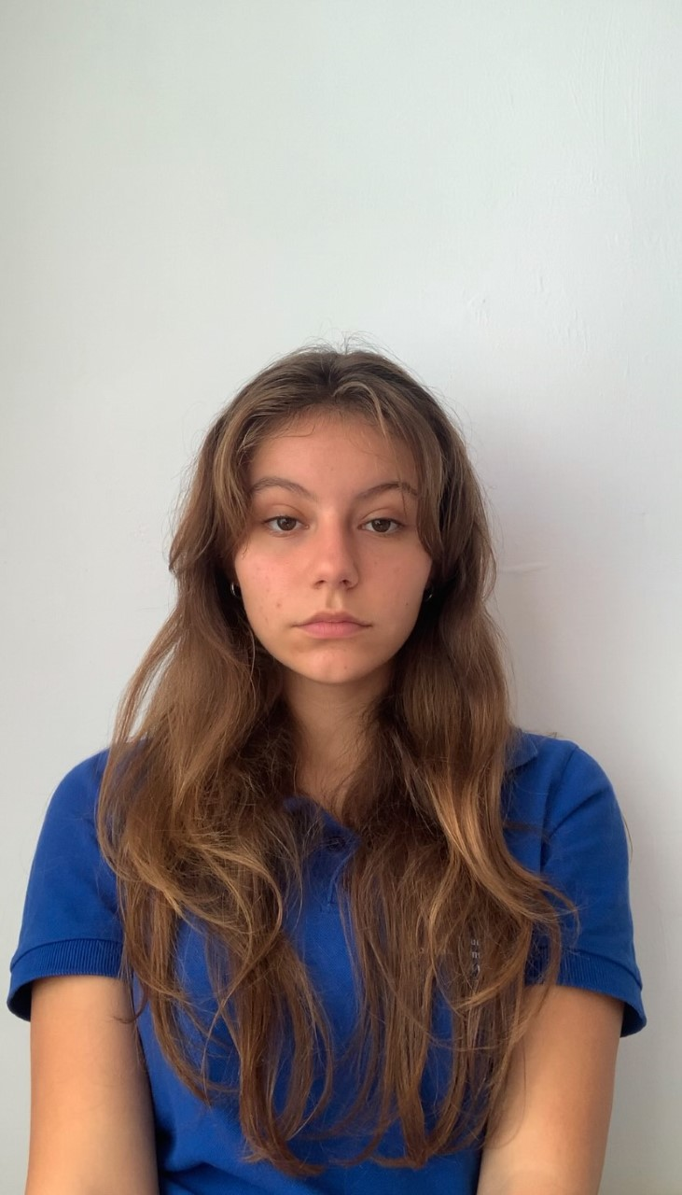
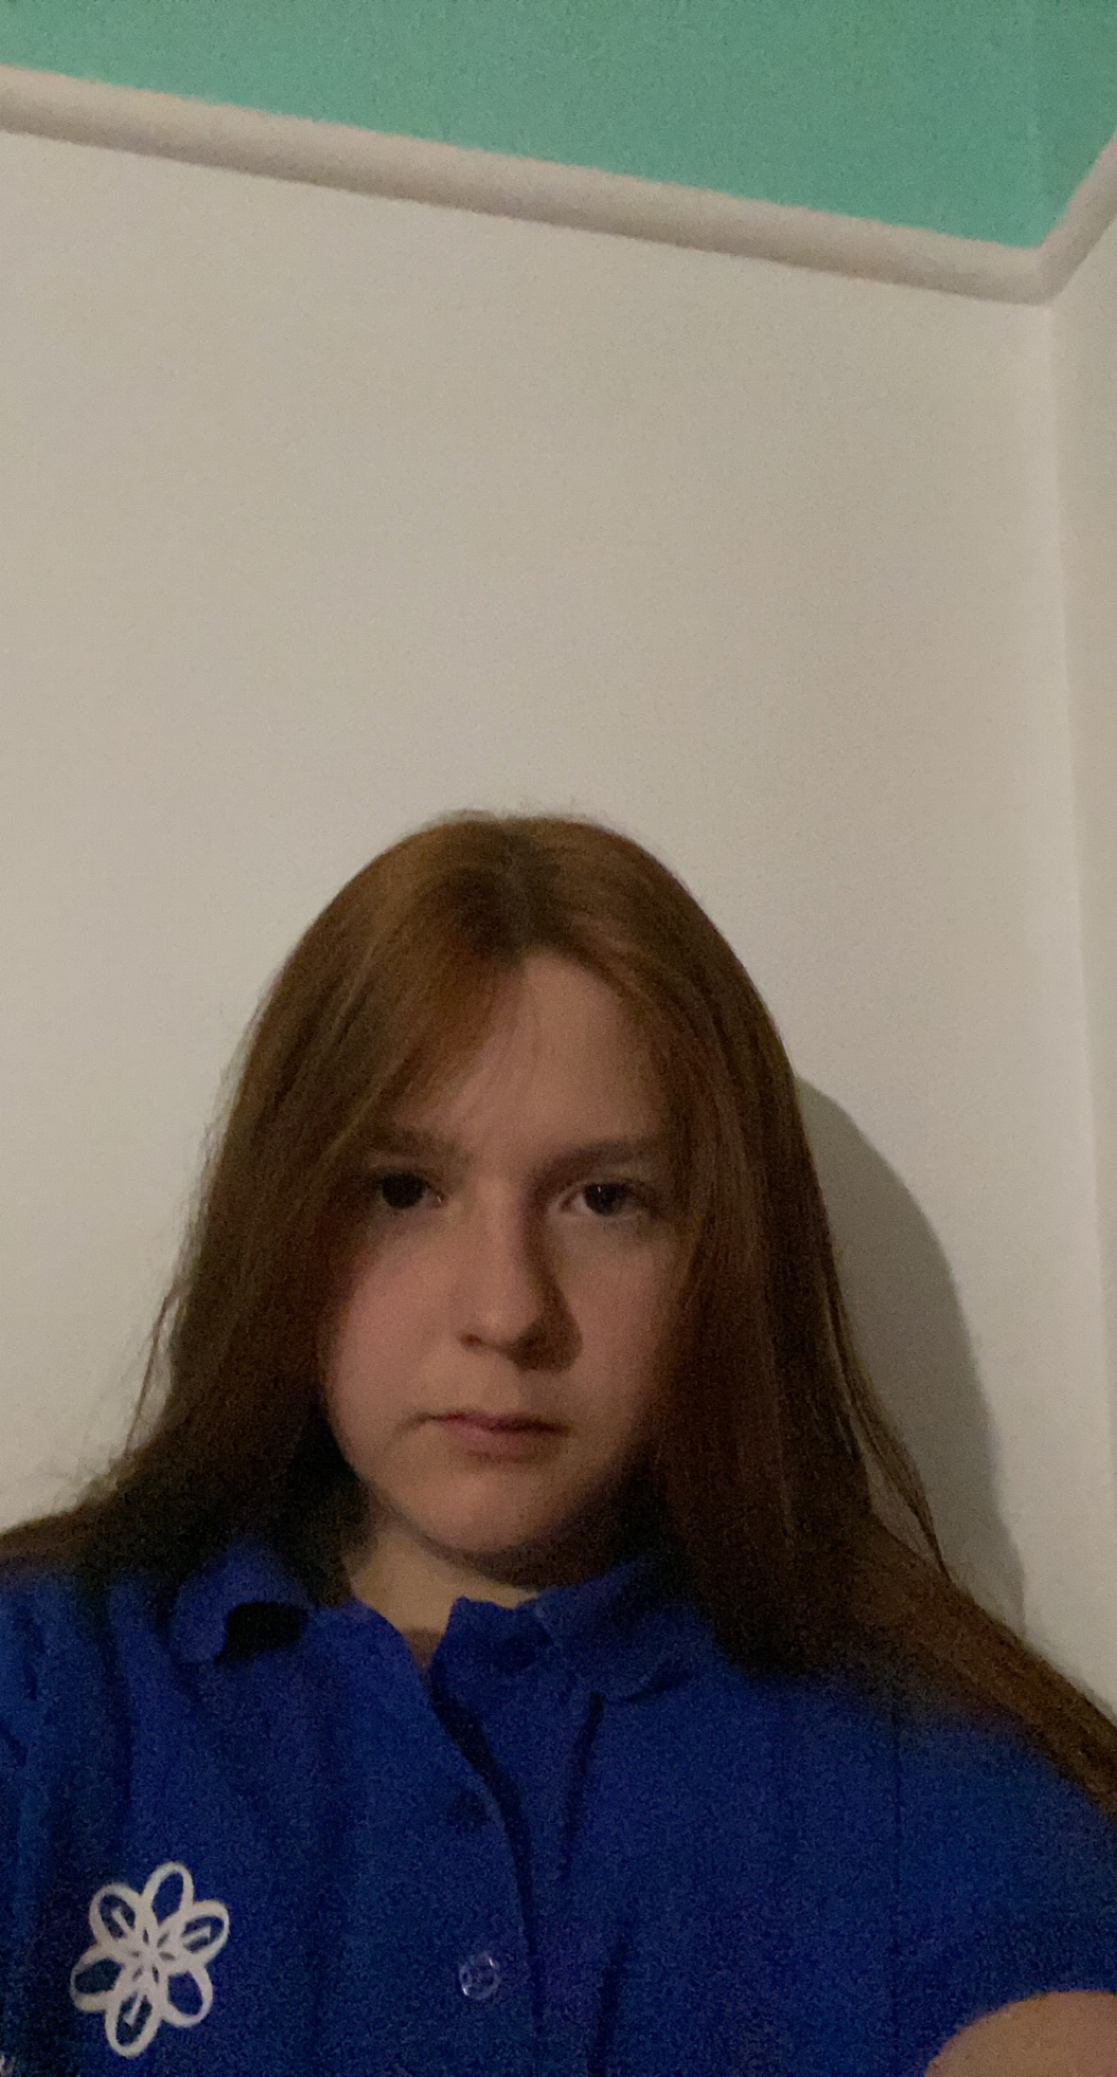
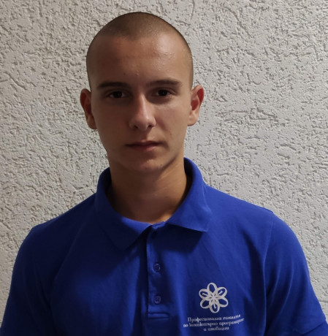
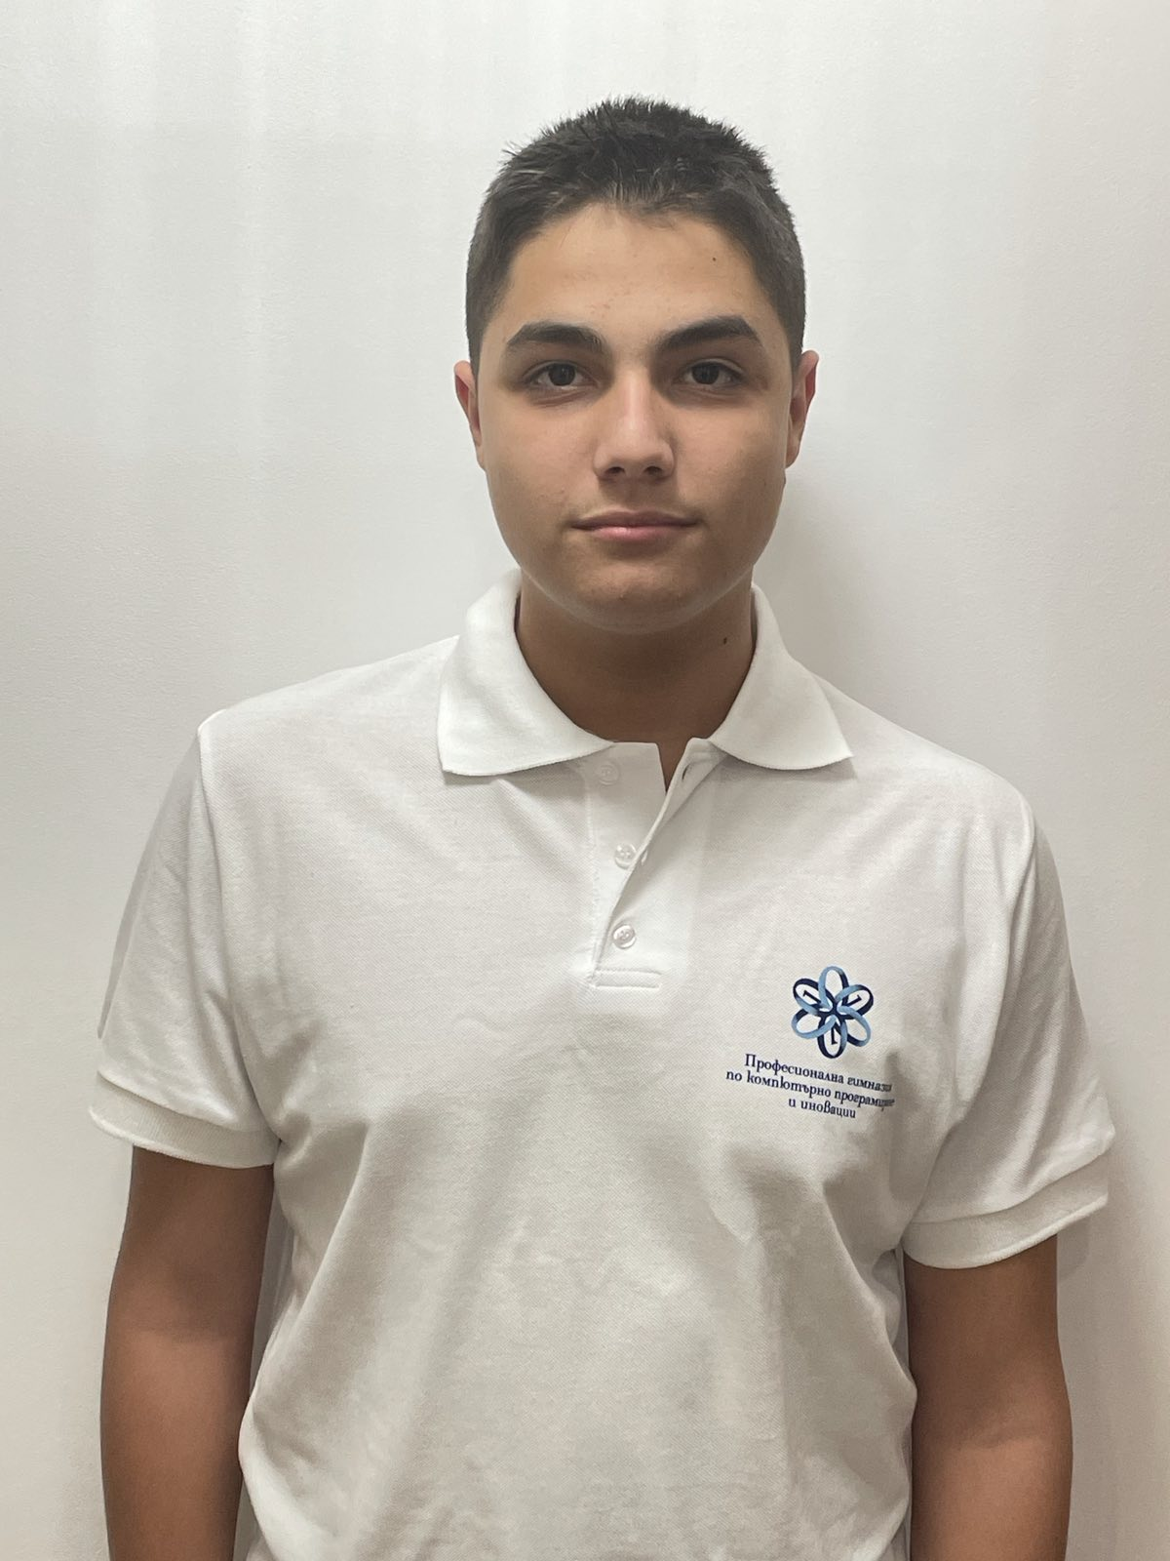
Meet The Team
Maria Ilcheva Back-End Developer
Vanina Teneva QA Engineer
Martin Mechkov Scrum Trainer
Hristo Kovachev
Front-End Developer

Slide 3










Used Programs and Technologies

Slide 4
Steps of work
IDEA
REALIZATION
POLISHING
1
3
5
2
4
6
ORGANIZATION
TESTING
PRESENTING

Slide 5




Project Summery
RANDOMIZED DEPTH-FIRST SEARCH
RECURSIVE BACKTRACKING ALGORITHM

Slide 6





Future Ideas

Slide 7

Thank You For Your Attention
Thank You For Your Attention

